Slide 1

Green Pace
Security Policy Presentation
Developer: Jessie Smith

Slide 2

OVERVIEW: DEFENSE IN DEPTH
Our security policy includes defense in depth (DiD), the process of including multiple layers of security to ensure secure coding. When one layer is broken, another still exists. Redundancy is one of the main parts of creating a successful DiD security system for software.

Slide 3
THREATS MATRIX
 |  | Priority and Threat Level
Probability | Low | Medium | High
Likely |  |  | STD-003-CPP STD-005-CPP
Probable | STD-007-CPP STD-009-CPP | STD-008-CPP
Unlikely | STD-002-CPP STD-004-CPP STD-006-CPP STD-001-CPP | STD-001-CPP STD-010-CPP
Each threat has a level of probability, and a threat/priority level. This helps us determine the impact of the standards. Here is a table that includes all our standards in our policy:

Slide 4
10 PRINCIPLES
Validate Input Data
STD-001-CPP
STD-003-CPP
STD-008-CPP
Heed Compiler Warnings
ALL
Architect and Design for Security Policies
STD-004-CPP
STD-005-CPP
STD-006-CPP
STD-007-CPP
STD-009-CPP
STD-010-CPP
Keep it Simple
STD-003-CPP
STD-010-CPP
Default Deny
6. Adhere to the Principle of Least Privilege
7. Sanitize Data Sent to Other Systems
Practice Defense in Depth
STD-005-CPP
STD-007-CPP
Use Effective Quality Assurance Techniques
ALL
Adopt a Secure Coding Standard
ALL

Slide 5
CODING STANDARDS
Each of the coding standards gain their priority level based on their severity, their likelihood, and their remediation cost.
The more severe and likely they are, the more prioritized they are.
The less severe and likely they are, the less prioritized they are.
Rule | Severity | Likelihood | Remediation Cost | Priority | Level
STD-003-CPP | High | Likely | Medium | P18 (high) | L1
STD-005-CPP | High | Likely | Medium | P18 (high) | L1
STD-008-CPP | High | Probable | High | P6 (medium) | L2
STD-010-CPP | High | Unlikely | Medium | P6 (medium) | L2
STD-001-CPP | Medium | Unlikely | Medium | P4 (low) | L3
STD-007-CPP | Low | Probable | Medium | P4 (low) | L3
STD-009-CPP | Low | Probable | Medium | P4 (low) | L3
STD-002-CPP | Low | Unlikely | Low | P3 (low) | L3
STD-004-CPP | Low | Unlikely | Medium | P2 (low) | L3
STD-006-CPP | Low | Unlikely | High | P1 (low) | L3

Slide 6
ENCRYPTION POLICIES
Encryption at rest
Encryption at rest is the practice of encrypting data when it is stored on a physical drive (when the data is at “rest”), like a hard drive, SSD, etc. This ensures that the data remains confidential and cannot be accessed by unauthorized users. Encryption at rest should be used when securing sensitive data that could be used for malicious purposes if accessed by unauthorized users.
Encryption in flight
Encryption in flight is the practice of encrypting data while it is being transmitted from one location to another (while it is in “flight”), this includes private or wireless networks. This helps prevent attacks like man-in-the-middle attacks, where the data could be intercepted. Securing communications helps ensure that this does not happen, and if intercepted it still cannot be accessed.
Encryption in use
Encryption is use is the practice of protecting and encrypting data while it is being processed. Allowing data to be utilized without needing to decrypt it first helps prevent data breaches. Ensuring that data in memory stays encrypted helps prevent users with malicious intents from gaining access to it.

Slide 7
TRIPLE-A POLICIES
Authentication
Authentication is the practice of verifying the identity of a user before granting access to data. This helps prevent unauthorized access and protects sensitive data. Using roles, passwords, MFA, etc. helps ensure that authentication is in place.
Authorization
Authorization is the practice of assigning roles and permissions to particular authenticated users. Assigning roles is one of the main ways this takes place, for instance admin roles may be able to access more data than user roles. This helps prevent data breaches.
Accounting
Accounting is the practice of logging and monitoring user activities and system events. This helps detect potential security breaches or attacks during and after they occur. This also helps identify the source or cause of the breach or attack.

Slide 8
Unit Testing
Unit testing is a good way to ensure that policies, standards, and best practices are being followed.
Unit testing helps with early detection of bugs, improves quality of code, reduces debugging time and costs, and enhances the reliability of the code.

Slide 9
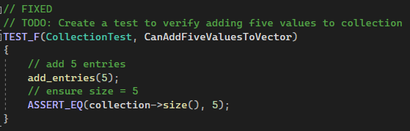
CanAddFiveValuesToVector

Slide 10
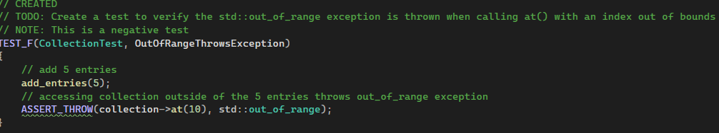
OutOfRangeThrowsException

Slide 11
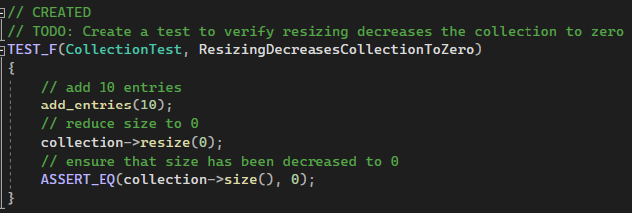
ResizingDecreasesCollectionToZero

Slide 12
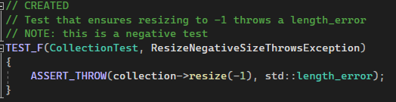
ResizeNegativeThrowsException

Slide 13

AUTOMATION SUMMARY
Automation will be used for the enforcement of and compliance to the standards in our policy.
Automation should be used throughout the entire process and after release to enhance efficiency, find and correct errors, provide a better experience, etc.

Slide 14
TOOLS
DevSecOps refers to development, security and operations.
DevSecOps helps us ensure that security is considered throughout every step of the SDLC and not just at the end of development.
Azure DevOps: Used during the Assess and Planning stage.
OWASP Threat Dragon: Used during the design phase.
Snyk: Used during the build phase.
LoadNinja: Used during the verify and test stage.
Intruder: Used during the health check stage.
Splunk: Used during the monitoring and detecting stage.
Snort: Used during the respond step.
Commvault: Used to maintain and stabilize.

Slide 15
RISKS AND BENEFITS
Acting Now
Waiting
Instant security improvement.
Enhanced performance.
Cost may be high.
Waiting allows for more planning time and allocation of resources.
Exposure time increases.
Performance drops.
Loss of trust.

Slide 16
RISKS AND BENEFITS
BENEFITS
Prevents security vulnerabilities.
Implementation throughout increases effectiveness.
Can save money in the long run.
Increases customer trust.
RISKS
Cost.
Time.
More complex.

Slide 17
RECOMMENDATIONS
Gaps:
How do we respond to attacks?
Which tools should be used and which tools should not be used?
Will there be training?
Not all principles have standards that fall under them.
Moving Forward:
We will use planning to ensure we are ready to respond to attacks.
As we move forward, more tools will become available,
Accidents and errors are expected, training will help increase the effectiveness of the policy.
Introduce more standards as we move forward.

Slide 18
CONCLUSIONS
Validate Input Data
Heed Compiler Warnings
Architect and Design for Security Policies
Keep It Simple
Default Deny
Adhere to the Principle of Least Privilege
Sanitize Data Sent to Other Systems
Practice Defense in Depth
Use Effective Quality Assurance Techniques
Adopt a Secure Coding Standard

Slide 19
REFERENCES
Azure Devops Services: Microsoft Azure. Services | Microsoft Azure. (n.d.). https://azure.microsoft.com/en-us/products/devops
Commvault documentation. (n.d.). https://documentation.commvault.com/
Content encryption: In Flight and at rest. (n.d.). https://www.ibm.com/docs/en/aspera-on- cloud?topic=encryption- content-in-flight-rest
Developer security. Snyk. (n.d.). https://snyk.io/?utm_medium=paid- search&utm_source=google&utm_campaign=gs_sn%3A-brand- ecpc&utm_content=br_ex&utm_term=snyk&gad_source=1&gclid=Cj0KCQjwj9 -zBhDyARIsAERjds3WAZOSnXxjo0It_OUwS51rEXLZNr5endSWOpRRPkOz_- ZHVOXnWTYaAtrKEALw_wcB
Gillis, A. S. (2023, October 11). What is authentication, Authorization and Accounting?: Definition from TechTarget. Security. https://www.techtarget.com/searchsecurity/definition/authentication- authorization- and-accounting
Network Intrusion Detection & Prevention System. Snort. (n.d.). https://www.snort.org/
No learning curve. no correlations. just real-world accuracy. LoadNinja. (n.d.). https://loadninja.com/

Slide 20
REFERENCES
Owasp threat dragon. OWASP Threat Dragon | OWASP Foundation. (n.d.). https://owasp.org/www- project-threat-dragon/
Sei cert C++ coding standard. SEI CERT C++ Coding Standard - SEI CERT C++ Coding Standard - Confluence. (n.d.-b). https://wiki.sei.cmu.edu/confluence/pages/viewpage.action?pageId= 88046682
Splunk attack analyzer. Splunk. (n.d.). https://www.splunk.com/en_us/products/attack-analyzer.html
Velimirovic, A. (2023a, November 16). Data Encryption in use explained. phoenixNAP Blog. https://phoenixnap.com/blog/encryption-in-use
Vulnerability Management Made Easy. Intruder. (n.d.). https://www.intruder.io/?utm_feeditemid=&utm_device=c&utm_term=intruder+software&ut m_source=google&utm_medium=ppc&utm_campaign=NA_US%2BCA%2B%7C%2BSearch%2 B%7C%2BBrand%2B%7C%2BAll&hsa_cam=6517984292&hsa_grp=80858830720&hsa_mt=p&hs a_src=g&hsa_ad=460122756653&hsa_acc=3411228400&hsa_net=adwords&hsa_kw=intruder+ software&hsa_tgt=kwd-1706790218557&hsa_ver=3&gad_source=1&gclid=Cj0KCQjwj9- zBhDyARIsAERjds3Utz2klhZMJexyL56R5OaWO2NcC1eTixdEEJghN23pY_4tWdgTlokaAh6cEALw _wcB
What is defense in depth? | layered security | cloudflare. Cloudflare. (n.d.). https://www.cloudflare.com/learning/security/glossary/what-is- defense-in- depth/

